Slide 1

Mindreading & Joint Action
Mindreading & Joint Action
2. What are mental states?
butterfillS@ceu.hu
butterfillS@ceu.hu
Notes:
Last week I suggested that we don’t adequately understand what mindreading is.
Of course we can *define* mindreading.
Mindreading is the process of identifying mental states and actions as the mental states and actions of a particular subject on the basis, ultimately, of bodily movements and their absence, somewhat as reading is the process of identifying propositions on the basis of inscriptions (Apperly 2010, p. 4).
Not adequately understanding mindreading means that there are questions we can’t answer, and puzzles we can’t resolve, and that a deeper understanding of what mindreading is might be needed to answer those questions and resolve those puzzles.
Anyway, this week I start from the assumption that we agree on wanting a deeper understanding of what mindreading is.
As mindreading is defined in terms of mental states, the natural question to ask is,
What are mental states?
Need to be careful here. Since our interest is in mindreading, we don’t necessarily want the truth about mental states. We merely want a theoretically coherent conception of them.

Slide 2
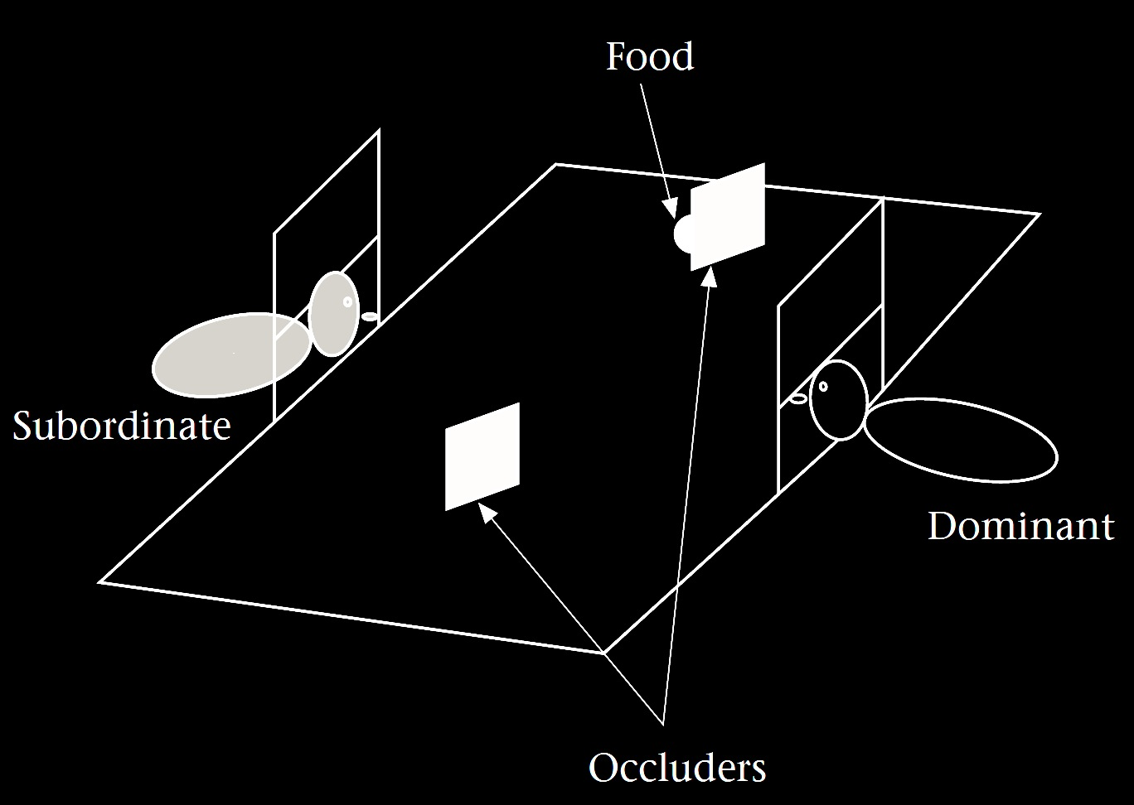
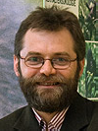
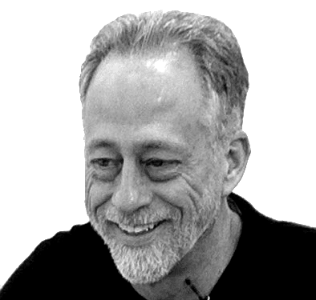
‘chimpanzees understand … intentions … perception and knowledge … Moreover, they understand how these psychological states work together to produce intentional action’
(Call & Tomasello 2008:191)
Notes:
To illustrate the need for this, consider Call & Tomasello’s claim.
What are Call & Tomasello saying the chimps understand?

Slide 3
‘chimpanzees understand … intentions … perception and knowledge … Moreover, they understand how these psychological states work together to produce intentional action’
(Call & Tomasello 2008:191)
Notes:
First note that this is a claim about understanding. They are not saying that chimps discriminate situations in which another knows from situations in which she is ignorant.
They are saying that chimps understand something about the knowledge states that constitute the difference between these situations.

Slide 4
‘chimpanzees understand … intentions … perception and knowledge … Moreover, they understand how these psychological states work together to produce intentional action’
(Call & Tomasello 2008:191)
Notes:
But what are they saying when they say that chimps understand knowledge? What does this amount to?

Slide 5
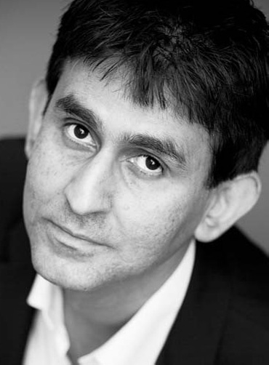
‘chimpanzees understand … intentions … perception and knowledge … Moreover, they understand how these psychological states work together to produce intentional action’
(Call & Tomasello 2008:191)
‘our fundamental conception of what it is to know that P is itself an explanatory conception […] we think of S’s knowledge that P as something that can properly be explained by reference to what S has perceived or remembered or proved or ...’
(Cassam 2007: 356)
Notes:
Take Quassim Cassam ... are they saying that Chimpanzees have this conception of knowledge? Probably not. After all, they may not want to be committed to saying that chimpanzees think of knowledge states as standing in need of explanation; they may not want to claim that chimpanzees sometimes think to themselves, I wonder how she knew about that?
But then what conception of knowledge do Call & Tomasello think chimpanzees have?
I think that this quote is fine if it is intended just to give us a very rough idea about what chimpanzees think.
But it would be a mistake to think that it gives us deep insight into what chimpanzees represent that enables them to track knowledge states.
The problem is that, pre-theoretically, we don’t have a clear enough sense of what ‘knowledge’ is to know what might be involved in understanding knowledge.
My aim in asking what mental states are is this.
If we can characterise---or mischaracterise---knowledge, belief and others, then we might be in a position to be more explicit about what chimpanzees and humans and others understand

Slide 6
‘chimpanzees understand … intentions … perception and knowledge … Moreover, they understand how these psychological states work together to produce intentional action’
(Call & Tomasello 2008:191)
‘from 7 months on ... humans automatically compute other’s beliefs and seem to hold them in mind as alternative representations of the environment.’
(Kovács et al 2010: 1834)
Notes:
Now we can go back and ask whether these norms are part of different subjects’ understandings of the attitudes ...
But this hardly seems like a good question to ask.
What evidence might persuade us either way?
So I think there are two problems.
One is that there is no obvious basis for accepting or rejecting these claims about the attitudes.
The other is that this way of distinguishing the attitudes doesn’t seem to generate useful questions about mindreaders.
Fortunately there is a different approach, one that relies less on commonsense.
We want to get a sense of the space of possibilities ... of the different understandings one might have of intention, say.
Proposal: we should take a constructive approach---creature construction.
And we should have a model of the attitudes, one that is clearly enough explained that we can tell whether it is capable of explaining a given individual’s behaviour in a particular case.

Slide 7
Ayesha
Steve
Henry
...
believes
desires
intends
...
Ayesha will cycle up Hármashatár hill
s/he will cycle up Hármashatár hill
Henry will win the lottery
...
that
Notes:
subject --- attitude --- content

Slide 8
Ayesha
Steve
Henry
...
believes
desires
intends
...
Ayesha will cycle up Hármashatár hill
s/he will cycle up Hármashatár hill
Henry will win the lottery
...
that
Subject
Attitude
Content
Notes:
subject --- attitude --- content

Slide 9
Ayesha
Steve
Henry
...
believes
desires
intends
...
Ayesha will cycle up Hármashatár hill
s/he will cycle up Hármashatár hill
Henry will win the lottery
...
that
Subject
Attitude
Content
Notes:
subject --- attitude --- content

Slide 10
Ayesha
Steve
Henry
...
believes
desires
intends
...
Ayesha will cycle up Hármashatár hill
s/he will cycle up Hármashatár hill
Henry will win the lottery
...
that
Subject
Attitude
Content
Notes:
subject --- attitude --- content

Slide 11
Ayesha
Steve
Henry
...
believes
desires
intends
...
Ayesha will cycle up Hármashatár hill
s/he will cycle up Hármashatár hill
Henry will win the lottery
...
that
Subject
Attitude
Content
Notes:
The content is what distinguishes one belief from all others, or one desire from all others.
The content is also what determines whether a belief is true or false, and whether a desire is satisfied or unsatisfied.
There are two main tasks in constructing a theory of mental states.
The first task is to characterise the different attitudes.
This typically involves specifying their distinctive functional and normative roles.
The second task is to find a scheme for specifying the contents of mental states.
Let’s start with the second task and come back to the first. [***OR SHOULD I POSTPONE THE SECOND TASK UNTIL THE LECTURE ON MEASUREMENT?]

Slide 12
Ayesha
Steve
Henry
...
believes
desires
intends
...
Ayesha will cycle up Hármashatár hill
s/he will cycle up Hármashatár hill
Henry will win the lottery
...
that
Subject
Attitude
Content
Notes:
The second task is to find a scheme for specifying the contents of mental states.
Usually this is done with propositions.
But what are propositions?
Propositions are abstract objects like numbers.
They have more mystique than numbers, but, like numbers, they are abstract objects that can be constructed using sets plus a few other basic ingredients such as objects, properties and possible worlds.

Slide 13
Ayesha
Steve
Henry
...
believes
desires
intends
...
Ayesha will cycle up Hármashatár hill
s/he will cycle up Hármashatár hill
Henry will win the lottery
...
that
Subject
Attitude
Content
Notes:
The second task is to find a scheme for specifying the contents of mental states.
Usually this is done with propositions.
But what are propositions?
Propositions are abstract objects like numbers.
They have more mystique than numbers, but, like numbers, they are abstract objects that can be constructed using sets plus a few other basic ingredients such as objects, properties and possible worlds.

Slide 14
‘Propositions ... are the sharable objects of the attitudes and the primary bearers of truth and falsity’ (McGrath 2012)
Ayesha
Steve
Henry
...
believes
desires
intends
...
Ayesha will cycle up Hármashatár hill
s/he will cycle up Hármashatár hill
Henry will win the lottery
...
that
Subject
Attitude
Content
Notes:
There are actually quite a few different views about what propositions are.
For example, McGrath says that ‘Propositions ... are the sharable objects of the attitudes and the primary bearers of truth and falsity’ \citep{McGrath:2012pro}.
Others introduce propositions by appeal to sentences, or utterances of sentences. Here the idea is that a proposition is what the utterance of a sentence expresses and that in virtue of which the utterance is true or false (as well as that in virtue of which it is necessary, if it is necessary). \citep{King:2011pro}

Slide 15
???
‘Propositions ... are the sharable objects of the attitudes and the primary bearers of truth and falsity’ (McGrath 2012)
Ayesha
Steve
Henry
...
believes
desires
intends
...
Ayesha will cycle up Hármashatár hill
s/he will cycle up Hármashatár hill
Henry will win the lottery
...
that
Subject
Attitude
Content
Notes:
We can remain agnostic about these ideas and think about propositions simply as abstract objects like numbers.
Just as there are different kinds of number---natural, rational and real, for instance---there are also different kinds of proposition.
And just as one way to get a handle on what numbers are is to see how they can be constructed from more basic ingredients, like sets, so equally one way to get a handle on propositions is to see how they can be constructed from ingredients we are already familiar with.
Propositions are abstract objects like numbers.
They have more mystique than numbers, but, like numbers, they are abstract objects that can be constructed using sets plus a few other basic ingredients such as objects, properties and possible worlds.

Slide 16
???
‘Propositions ... are the sharable objects of the attitudes and the primary bearers of truth and falsity’ (McGrath 2012)
Ayesha
Steve
Henry
...
believes
desires
intends
...
Ayesha will cycle up Hármashatár hill
s/he will cycle up Hármashatár hill
Henry will win the lottery
...
that
Subject
Attitude
Content
Notes:
I’m about to explain how to construct propositions.
But you might ask why we are bothering.
We already have abstract objects, namely sentences.
Why not just use sentences to specify the contents of mental states?
That’s only because sentences are not suitable for this purpose.
We want a collection of abstract objects that we can use to specify the contents of mental states; so, ideally, we would set things up so that there is only one belief corresponding to each abstract object.
And sentences don’t have this property.
Take the sentence, "s/he will cycle up Hármashatár hill”
This sentence refers to different desires depending on who the subject is.
(What I desire when I cycle up the hill is different from what you desire when you desire that you cycle up the hill; after all, one of these desires might be satisfied while the other is not.)
So we can’t use sentences to specify the contents of mental states because some sentences are associated with indefinitely many different beliefs.
Instead we need a collection of abstract object such that we can associate at most one belief associated with each object.
You might think we could get around this by avoiding using sentences that contain ‘she’ and other indexicals.
But John Perry has shown that this is impossible.
The problem in a nutshell is that Ayesha’s desire that she cycle up the hill is different from her desire that Ayesha cycle up the hill because even though she is Ayesha, she might not know that.
You might think something must have gone wrong here.
We use utterances of sentences to identify what someone believes or desires all the time.
After all, I can tell you what someone desires like this: "Mo desires that s/he will cycle up Hármashatár hill".
So how can I be saying that we can’t use sentences to distinguish the contents of mental states?
The answer is simple.
When we utter a sentence we express a proposition.
And it is the proposition, not the sentence, that we use to specify the content of a belief or desire or other mental state.
So there is no getting away from propositions.
But they’re also not particularly mysterious either.

Slide 17
proposition-1 : a set of possible worlds
Ayesha
Steve
Henry
...
believes
desires
intends
...
Ayesha will cycle up Hármashatár hill
s/he will cycle up Hármashatár hill
Henry will win the lottery
...
that
Subject
Attitude
Content

Slide 18
proposition-1 : a set of possible worlds
Ayesha
Steve
Henry
...
believes
desires
intends
...
Ayesha will cycle up Hármashatár hill
s/he will cycle up Hármashatár hill
Henry will win the lottery
...
that
Subject
Attitude
Content
Notes:
say what a possible world is

Slide 19
proposition-1 : a set of possible worlds
Ayesha
Steve
Henry
...
believes
desires
intends
...
Ayesha will cycle up Hármashatár hill
s/he will cycle up Hármashatár hill
Henry will win the lottery
...
that
Subject
Attitude
Content

Slide 20
proposition-1 : a set of possible worlds
Ayesha will cycle up Hármashatár hill and 97²=9049
Ayesha
Steve
Henry
...
believes
desires
intends
...
Ayesha will cycle up Hármashatár hill
s/he will cycle up Hármashatár hill
Henry will win the lottery
...
that
Subject
Attitude
Content
Notes:
explain the limitations of this view (necessity)

Slide 21
proposition-1 : a set of possible worlds
proposition-2 : a (nested) sequence of objects and properties
Ayesha
Steve
Henry
...
believes
desires
intends
...
Ayesha will cycle up Hármashatár hill
s/he will cycle up Hármashatár hill
Henry will win the lottery
...
that
Subject
Attitude
Content
Notes:
This gets us around the 97^2=9049 problem because the number 97 is a constituent of one proposition-2 but not the other.

Slide 22
proposition-1 : a set of possible worlds
proposition-2 : a (nested) sequence of objects and properties
< < Ayesha , Hármashatár hill >, cycle >
Ayesha
Steve
Henry
...
believes
desires
intends
...
Ayesha will cycle up Hármashatár hill
s/he will cycle up Hármashatár hill
Henry will win the lottery
...
that
Subject
Attitude
Content
Notes:
This gets us around the 97^2=9049 problem because the number 97 is a constituent of one proposition-2 but not the other.

Slide 23
proposition-1 : a set of possible worlds
proposition-2 : a (nested) sequence of objects and properties
< < Ayesha , Hármashatár hill >, cycle >
< < Steve , Hármashatár hill >, cycle >
Ayesha
Steve
Henry
...
believes
desires
intends
...
Ayesha will cycle up Hármashatár hill
s/he will cycle up Hármashatár hill
Henry will win the lottery
...
that
Subject
Attitude
Content
Notes:
But there is a second problem. Suppose Steve = Ayesha. Then these are the same propositions. But someone might have different beliefs. ... This is Oedipus and Jocasta ... which became te story of Heinz and his rubber in the work of Liz Robinson and Ian Apperly ... It’s impossible for these propositions to cut more finely than there are individuals in the world. But it seems that mental states can cut more finely. So perhaps we need a third kind of proposition.

Slide 24
proposition-1 : a set of possible worlds
proposition-2 : a (nested) sequence of objects and properties
Why not use sentences?
< < Ayesha , Hármashatár hill >, cycle >
< < Steve , Hármashatár hill >, cycle >
Ayesha
Steve
Henry
...
believes
desires
intends
...
Ayesha will cycle up Hármashatár hill
s/he will cycle up Hármashatár hill
Henry will win the lottery
...
that
Subject
Attitude
Content
Notes:
But there is a second problem. Suppose Steve = Ayesha. Then these are the same propositions. But someone might have different beliefs. ... This is Oedipus and Jocasta ... which became te story of Heinz and his rubber in the work of Liz Robinson and Ian Apperly ... It’s impossible for these propositions to cut more finely than there are individuals in the world. But it seems that mental states can cut more finely. So perhaps we need a third kind of proposition.

Slide 25
proposition-1 : a set of possible worlds
proposition-2 : a (nested) sequence of objects and properties
Why not use sentences?
< < Ayesha , Hármashatár hill >, cycle >
< < Steve , Hármashatár hill >, cycle >
Ayesha
Steve
Henry
...
believes
desires
intends
...
Ayesha will cycle up Hármashatár hill
s/he will cycle up Hármashatár hill
Henry will win the lottery
...
that
Subject
Attitude
Content
Notes:
But there is a second problem. Suppose Steve = Ayesha. Then these are the same propositions. But someone might have different beliefs. ... This is Oedipus and Jocasta ... which became te story of Heinz and his rubber in the work of Liz Robinson and Ian Apperly ... It’s impossible for these propositions to cut more finely than there are individuals in the world. But it seems that mental states can cut more finely. So perhaps we need a third kind of proposition.

Slide 26
proposition-1 : a set of possible worlds
proposition-2 : a (nested) sequence of objects and properties
Why not use sentences?
< < Ayesha , Hármashatár hill >, cycle >
< < Steve , Hármashatár hill >, cycle >
Ayesha
Steve
Henry
...
believes
desires
intends
...
Ayesha will cycle up Hármashatár hill
s/he will cycle up Hármashatár hill
Henry will win the lottery
...
that
Subject
Attitude
Content
Notes:
But there is a second problem. Suppose Steve = Ayesha. Then these are the same propositions. But someone might have different beliefs. ... This is Oedipus and Jocasta ... which became te story of Heinz and his rubber in the work of Liz Robinson and Ian Apperly ... It’s impossible for these propositions to cut more finely than there are individuals in the world. But it seems that mental states can cut more finely. So perhaps we need a third kind of proposition.

Slide 27
proposition-1 : a set of possible worlds
proposition-2 : a (nested) sequence of objects and properties
proposition-3 : a (nested) sequence of objects and properties
and modes of presentations
Ayesha
Steve
Henry
...
believes
desires
intends
...
Ayesha will cycle up Hármashatár hill
s/he will cycle up Hármashatár hill
Henry will win the lottery
...
that
Subject
Attitude
Content
Notes:
Third type of proposition gets around all these problems.
So with the third type of proposition we have found a scheme for specifying the contents of mental states that seems to allow us to make as many distinctions as human adults intuitively make.
What can we conclude so far about representing mental states?
Someone who represents mental states needs some system of abstract objects, such as some kind of proposition, in order to have a way of distinguishing among their contents.
This doesn’t mean that they have to represent Fregean propositions: after all, they might represent mental states without being able to specify every possible difference in content.
So I’m not suggesting that anyone who represents mental states must be able to represent Fregean propositions.
The point is rather just that we understand what sort of thing is required ... and how different abstract objects that could be used to distinguish among the contents of mental states impose different limits.
[***Next issue: relation between beliefs and propositions --- are propositions *objects* of belief or are they simply measuring devices?
I will come back to this issue in Lecture 3 (on measuring, tracking & representing beliefs).]

Slide 28
proposition-1 : a set of possible worlds
proposition-2 : a (nested) sequence of objects and properties
proposition-3 : a (nested) sequence of objects and properties
and modes of presentations
Ayesha
Steve
Henry
...
believes
desires
intends
...
Ayesha will cycle up Hármashatár hill
s/he will cycle up Hármashatár hill
Henry will win the lottery
...
that
Subject
Attitude
Content
Notes:
From the point of view of theory of mind, it’s interesting that there are different sorts of proposition that you can use to distinguish the contents of attitudes, to distinguish one belief from another.
Some are simpler but allow for fewer distinctions, whereas others are richer but allow you to make additional distinctions between beliefs.
And there are other sorts of things we can use to distinguish beliefs in more coarse-grained ways.
For example, you could use maps. This would be quite crude in the sense that there would be many beliefs you couldn’t distinguish at all --- for instance beliefs essentially involving quantification, such as the belief that there are at least two trees, and beliefs about events might also be a problem.

Slide 29
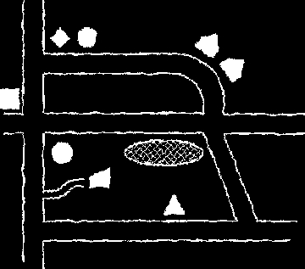
proposition-1 : a set of possible worlds
proposition-2 : a (nested) sequence of objects and properties
proposition-3 : a (nested) sequence of objects and properties
and modes of presentations
Ayesha
Steve
Henry
...
believes
desires
intends
...
Ayesha will cycle up Hármashatár hill
s/he will cycle up Hármashatár hill
Henry will win the lottery
...
that
Subject
Attitude
Content
Notes:
From the point of view of theory of mind, it’s interesting that there are different sorts of proposition that you can use to distinguish the contents of attitudes, to distinguish one belief from another.
Some are simpler but allow for fewer distinctions, whereas others are richer but allow you to make additional distinctions between beliefs.
And there are other sorts of things we can use to distinguish beliefs in more coarse-grained ways.
For example, you could use maps. This would be quite crude in the sense that there would be many beliefs you couldn’t distinguish at all --- for instance beliefs essentially involving quantification, such as the belief that there are at least two trees, and beliefs about events might also be a problem.

Slide 30
‘chimpanzees understand … intentions … perception and knowledge … Moreover, they understand how these psychological states work together to produce intentional action’
(Call & Tomasello 2008:191)
Notes:
So let’s return to Call & Tomasello.
Our first question in being more precise about their proposal is: What sort of abstract object do chimpanzees use to specify the contents of mental states (for example, to distinguish one intention from another)?
In the next lecture I’m going to compare attributing mental states to measuring temperature.
If you think chimpanzees can measure temperature, it makes sense to ask what sort of units they use to measure temperature. E.g. do they use numbers or some other kind of scale?
Similarly, if we think chimpanzees can measure mental states, we can ask what sort of abstract objects they use to do this.
And, as we saw, different answers have different consequences for the limits of their abilities to represent mental states.
So there is even some hope that different hypotheses about which abstract objects chimpanzees use might generate testable predictions.

Slide 31
‘chimpanzees understand … intentions … perception and knowledge … Moreover, they understand how these psychological states work together to produce intentional action’
(Call & Tomasello 2008:191)
‘from 7 months on ... humans automatically compute other’s beliefs and seem to hold them in mind as alternative representations of the environment.’
(Kovács et al 2010: 1834)
Notes:
.... and of course we have to ask the same question about infants and adults.
And we should maybe not take for granted that chimpanzees, infants and adults all use the same system of abstract objects to distinguish the contents of mental states.

Slide 32
Ayesha
Steve
Henry
...
believes
desires
intends
...
Ayesha will cycle up Hármashatár hill
s/he will cycle up Hármashatár hill
Henry will win the lottery
...
that
Subject
Attitude
Content
Notes:
Now to the other task ... how to characterise the attitudes?

Slide 33
‘(4) For any p: One ought to believe that p only if p.
‘the holding of this norm is one of the defining features of the notion of belief [...] That [...] is what makes it the state that it is.’
(Boghossian 2003: 37, 38-9)
Notes:
Now to the other task ... how to characterise the attitudes?

Slide 34
‘(4) For any p: One ought to believe that p only if p.
‘the holding of this norm is one of the defining features of the notion of belief [...] That [...] is what makes it the state that it is.’
(Boghossian 2003: 37, 38-9)
‘Aside from our purposes in forming beliefs or in using beliefs as guides to action, there is nothing they should or shouldn’t be. … The only fault with fallacious reasoning, the only thing wrong or bad about mistaken judgements, is that, generally speaking, we don’t like them. We do our best to avoid them. They do not—most of the time at least—serve our purposes’
(Dretske 2000: 247-8)
Notes:
Now to the other task ... how to characterise the attitudes?

Slide 35
‘Rational intentions should be agglomerative. If at one and the same time I rationally intend to A and rationally intend to B then it should be both possible and rational for me, at the same time, to intend to A and B.’
(Bratman 1999: 220)
Notes:
Now to the other task ... how to characterise the attitudes?

Slide 36
‘chimpanzees understand … intentions … perception and knowledge … Moreover, they understand how these psychological states work together to produce intentional action’
(Call & Tomasello 2008:191)
‘from 7 months on ... humans automatically compute other’s beliefs and seem to hold them in mind as alternative representations of the environment.’
(Kovács et al 2010: 1834)
Notes:
Now we can go back and ask whether these norms are part of different subjects’ understandings of the attitudes ...
But this hardly seems like a good question to ask.
What evidence might persuade us either way?
So I think there are two problems.
One is that there is no obvious basis for accepting or rejecting these claims about the attitudes.
The other is that this way of distinguishing the attitudes doesn’t seem to generate useful questions about mindreaders.
Fortunately there is a different approach, one that relies less on commonsense.
We want to get a sense of the space of possibilities ... of the different understandings one might have of intention, say.
Proposal: we should take a constructive approach---creature construction.
And we should have a model of the attitudes, one that is clearly enough explained that we can tell whether it is capable of explaining a given individual’s behaviour in a particular case.

Slide 37
Merely purposive agent
Creature construction
Self-knowing, truth-seeking, embarrassed ... agent
Notes:
Proposal: we should take a constructive approach---creature construction.
And we should have a model of the attitudes, one that is clearly enough explained that we can tell whether it is capable of explaining a given individual’s behaviour in a particular case.
The point of creature construction is to ensure coherence. We want to have a functioning, viable creature at each stage. You can’t just take a fish and throw in feet. Having feet goes with certain kinds of limb structure and capacities for movement.
Where Call and Tomasello says chimps understand intentions but not beliefs, a reasonable question to ask is, what sort of creature has intentions but not beliefs. By attempting to construct the creature we would get a clearer idea of how, on their view, the chimpanzee understands minds. I’m not going to try that here, although I will offer a suggestion along these lines. Instead today I want to start in the middle, with the most sophisticated creature that we can construct using a well-understood model.
***Davidson quote is relevant here (about nothing in between)
***(not here) Another way to think of this is as constructing an imaginary world. We can maybe imagine a world, one much simpler than ours, where Netwtonian physics holds. Maybe it is even in some sense possible for such a world to exist. There is also a world where
***use Dretske naturalism quote?
***start with mere goals and add in states that modulate, or go straight to decision theory?

Slide 38
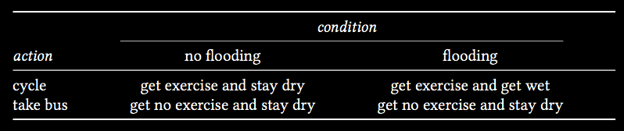
Actions, outcomes & conditions
Notes:
Proposal: we should take a constructive approach---creature construction.
And we should have a model of the attitudes, one that is clearly enough explained that we can tell whether it is capable of explaining a given individual’s behaviour in a particular case.
***use Dretske naturalism quote?
***start with mere goals and add in states that modulate, or go straight to decision theory?

Slide 39
Actions, outcomes & conditions
Notes:
Proposal: we should take a constructive approach---creature construction.
And we should have a model of the attitudes, one that is clearly enough explained that we can tell whether it is capable of explaining a given individual’s behaviour in a particular case.
***use Dretske naturalism quote?
***start with mere goals and add in states that modulate, or go straight to decision theory?

Slide 40
Actions, outcomes & conditions
Notes:
Proposal: we should take a constructive approach---creature construction.
And we should have a model of the attitudes, one that is clearly enough explained that we can tell whether it is capable of explaining a given individual’s behaviour in a particular case.
***use Dretske naturalism quote?
***start with mere goals and add in states that modulate, or go straight to decision theory?

Slide 41
Actions, outcomes & conditions
Notes:
Proposal: we should take a constructive approach---creature construction.
And we should have a model of the attitudes, one that is clearly enough explained that we can tell whether it is capable of explaining a given individual’s behaviour in a particular case.
***use Dretske naturalism quote?
***start with mere goals and add in states that modulate, or go straight to decision theory?

Slide 42
Actions, outcomes & conditions
Notes:
Proposal: we should take a constructive approach---creature construction.
And we should have a model of the attitudes, one that is clearly enough explained that we can tell whether it is capable of explaining a given individual’s behaviour in a particular case.
***use Dretske naturalism quote?
***start with mere goals and add in states that modulate, or go straight to decision theory?

Slide 43
Actions, outcomes & conditions
Notes:
Proposal: we should take a constructive approach---creature construction.
And we should have a model of the attitudes, one that is clearly enough explained that we can tell whether it is capable of explaining a given individual’s behaviour in a particular case.
***use Dretske naturalism quote?
***start with mere goals and add in states that modulate, or go straight to decision theory?

Slide 44
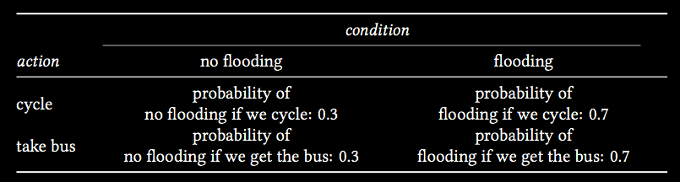
Actions, outcomes & conditions
Notes:
Proposal: we should take a constructive approach---creature construction.
And we should have a model of the attitudes, one that is clearly enough explained that we can tell whether it is capable of explaining a given individual’s behaviour in a particular case.
***use Dretske naturalism quote?
***start with mere goals and add in states that modulate, or go straight to decision theory?

Slide 45
Actions, outcomes & conditions
Notes:
Proposal: we should take a constructive approach---creature construction.
And we should have a model of the attitudes, one that is clearly enough explained that we can tell whether it is capable of explaining a given individual’s behaviour in a particular case.
***use Dretske naturalism quote?
***start with mere goals and add in states that modulate, or go straight to decision theory?

Slide 46
Actions, outcomes & conditions
Notes:
Proposal: we should take a constructive approach---creature construction.
And we should have a model of the attitudes, one that is clearly enough explained that we can tell whether it is capable of explaining a given individual’s behaviour in a particular case.
***use Dretske naturalism quote?
***start with mere goals and add in states that modulate, or go straight to decision theory?

Slide 47
Actions, outcomes & conditions
Notes:
Proposal: we should take a constructive approach---creature construction.
And we should have a model of the attitudes, one that is clearly enough explained that we can tell whether it is capable of explaining a given individual’s behaviour in a particular case.
***use Dretske naturalism quote?
***start with mere goals and add in states that modulate, or go straight to decision theory?

Slide 48
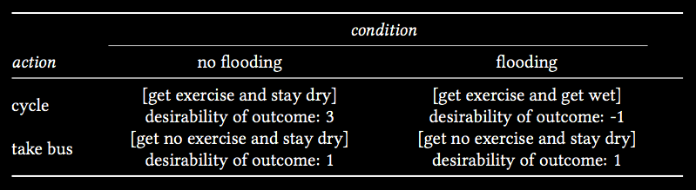
Actions, outcomes & conditions
Notes:
Proposal: we should take a constructive approach---creature construction.
And we should have a model of the attitudes, one that is clearly enough explained that we can tell whether it is capable of explaining a given individual’s behaviour in a particular case.
***use Dretske naturalism quote?
***start with mere goals and add in states that modulate, or go straight to decision theory?

Slide 49
Actions, outcomes & conditions
Notes:
Proposal: we should take a constructive approach---creature construction.
And we should have a model of the attitudes, one that is clearly enough explained that we can tell whether it is capable of explaining a given individual’s behaviour in a particular case.
***use Dretske naturalism quote?
***start with mere goals and add in states that modulate, or go straight to decision theory?

Slide 50
Actions, outcomes & conditions
Notes:
Proposal: we should take a constructive approach---creature construction.
And we should have a model of the attitudes, one that is clearly enough explained that we can tell whether it is capable of explaining a given individual’s behaviour in a particular case.
***use Dretske naturalism quote?
***start with mere goals and add in states that modulate, or go straight to decision theory?

Slide 51
‘Suppose that A and B are [outcomes] between which the agent is not indifferent, and that N is an ethically neutral condition [i.e. the agent is indifferent between N and not N].
Then N has probability 1/2 if and only if the agent is indifferent between the following two gambles.
B if N, A if not
A if N, B if not'
(Jeffrey 1983: 47)
Notes:
Want a method for determining subjective probabilities and subjective desirabilities from actions ... this ensures that the postulated states are knowable

Slide 52
‘Suppose that A and B are [outcomes] between which the agent is not indifferent, and that N is an ethically neutral condition [i.e. the agent is indifferent between N and not N].
Then N has probability 1/2 if and only if the agent is indifferent between the following two gambles.
B if N, A if not
A if N, B if not'
(Jeffrey 1983: 47)
Notes:
There are lots of good objections to the idea that decision theory is a complete model of human behaviour ... one of these concerns joint action and in the Sugden paper, another concerns intention and is the topic of a later lecture.
The virtue of the decision-theoretic model is not that it is *right* but that it is clear enough to have limits.

Slide 53
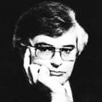
‘modern philosophers ... have no theory of thought to speak of. I do think this is appalling; how can you seriously hope for a good account of belief if you have no account of belief fixation?’
(Fodor 1987: 147)
Notes:
This is what is missing from the account so far ... it focuses on the way desire and belief lead to action, ignoring the issue of how beliefs are acquired.

Slide 54
Ayesha
Steve
Henry
...
believes
desires
intends
...
Ayesha will cycle up Hármashatár hill
s/he will cycle up Hármashatár hill
Henry will win the lottery
...
that
Subject
Attitude
Content
Notes:
So the task was how to characterise the attitudes?
Decision theory gives us a way of identifying attitudes like desire and belief without appeal to complexities like normative role.
But, unfortunately, it probably isn’t adequate as a theory of what these attitudes are, and it doesn’t straightforward give us an account of other attitudes like intending or loving.
So it is probably not a good model for explaining all of human action ... probably our mental lives are more complex than this allows.
But of course this doesn’t mean that it wouldn’t be a good model of the attitudes for a mindreader to adopt.

Slide 55
Merely purposive agent
Creature construction
Self-knowing, truth-seeking, embarrassed ... agent
Notes:
So we can imagine models of the attitudes that capture more complex than decision theory
And perhaps we can also develop models that capture even less complexity than decision theory as well.
These models could be taken as describing creatures with more and less sophisticated mental lives.

Slide 56
‘chimpanzees understand … intentions … perception and knowledge … Moreover, they understand how these psychological states work together to produce intentional action’
(Call & Tomasello 2008:191)
‘from 7 months on ... humans automatically compute other’s beliefs and seem to hold them in mind as alternative representations of the environment.’
(Kovács et al 2010: 1834)
Notes:
So when it comes to chimpanzees, we can ask two things about their understanding of mental states. First, what is their model of the attitudes; and, second, what sort of scheme to they use for distinguish attitudes with different contents?
The same goes for infant humans, and for adult humans as well.
After all, it’s a familiar idea that our thinking about the physical world might involve a variety of different models.
In lots of cases we can use a Newtonian theory as our working model of the world, or perhaps an even simpler one.
Just because we have discovered quantum mechanics doesn’t mean that we always have to use it.
When it comes to mindreading, I guess we’re sometimes more like engineers than scientists.
We want the simplest model that will give us results accurate enough for our purposes.
Another consequence of this view is that we shouldn’t assume that there is a massive chasm between abilities to think about behaviour and abilities to think about mental states.
After all, the process of applying a simple form of decision theory does not seem to require conceptual sophistication: anything from large-scale organisations to sensory-motor systems appear capable of implementing bayesian decision theory \citep{kording:2006_bayesian}. So it is not a huge stretch to suppose that relatively primitive, automatic mechanisms might provide an implementation that is used not for determining how to act oneself but for predicting others’ actions.
It may be, then, that abilities to represent mental states are quite widespread.

Slide 57
Objectivity
Could there be mindreaders who are able to identify differences in belief despite not understanding what it is for a belief to be true or false?
Self-awareness
Does being a mindreader entail being able, sometimes, to identify one's own mental states and actions?
Evidential basis
What evidence could in principle support the ascription of a particular belief to a given subject, and how does the evidence support the ascription?
Holism
Could there be mindreaders who can identify intentions and knowledge states but not beliefs?
Notes:
Now let’s return to the questions I posed last lecture as indicators that we don’t adequately understand mindreading

Slide 58
Objectivity
Could there be mindreaders who are able to identify differences in belief despite not understanding what it is for a belief to be true or false?
Self-awareness
Does being a mindreader entail being able, sometimes, to identify one's own mental states and actions?
Evidential basis
What evidence could in principle support the ascription of a particular belief to a given subject, and how does the evidence support the ascription?
Holism
Could there be mindreaders who can identify intentions and knowledge states but not beliefs?
Notes:
This now seems quite straightforward. Mastery of decision theory and ability to apply it to others seems no more connected to awareness of oneself as subject to the same laws than mastery of newtonian physics would require one to think of oneself as a physical object. It seems conceiveable that could be individuals who thought about the physical world without realising that one was oneself a physical object ...

Slide 59
Objectivity
Could there be mindreaders who are able to identify differences in belief despite not understanding what it is for a belief to be true or false?
Self-awareness
Does being a mindreader entail being able, sometimes, to identify one's own mental states and actions?
Evidential basis
What evidence could in principle support the ascription of a particular belief to a given subject, and how does the evidence support the ascription?
Holism
Could there be mindreaders who can identify intentions and knowledge states but not beliefs?
Notes:
This question is answered by Ramsey’s insight ... essentially the evidence is choice actions ...

Slide 60
Objectivity
Could there be mindreaders who are able to identify differences in belief despite not understanding what it is for a belief to be true or false?
Self-awareness
Does being a mindreader entail being able, sometimes, to identify one's own mental states and actions?
Evidential basis
What evidence could in principle support the ascription of a particular belief to a given subject, and how does the evidence support the ascription?
Holism
Could there be mindreaders who can identify intentions and knowledge states but not beliefs?
Notes:
Here we struggle. We should try to find some way to do this. But the natural way to proceed is to think of intention and knowledge as built on belief, as states involving more sophistication. So this would be like saying that there could be mindreaders (chimpanzees) who can think about force but not mass or acceleration.

Slide 61
Objectivity
Could there be mindreaders who are able to identify differences in belief despite not understanding what it is for a belief to be true or false?
Self-awareness
Does being a mindreader entail being able, sometimes, to identify one's own mental states and actions?
Evidential basis
What evidence could in principle support the ascription of a particular belief to a given subject, and how does the evidence support the ascription?
Holism
Could there be mindreaders who can identify intentions and knowledge states but not beliefs?
Notes:
I think the answer is yes ... but that is quite a long story.

Slide 62


